Slide 1
Personalized Public Displays
Juan Camilo Garcia Henri Koski Yifei Zuo Haejong Dong

Slide 2
Table of contents
Motivation
Design process
Prototypes
Implementation Process
Software Architecture
UI
Evaluation Process
System Evaluation
User Evaluation
Discussion and Future Work

Slide 3
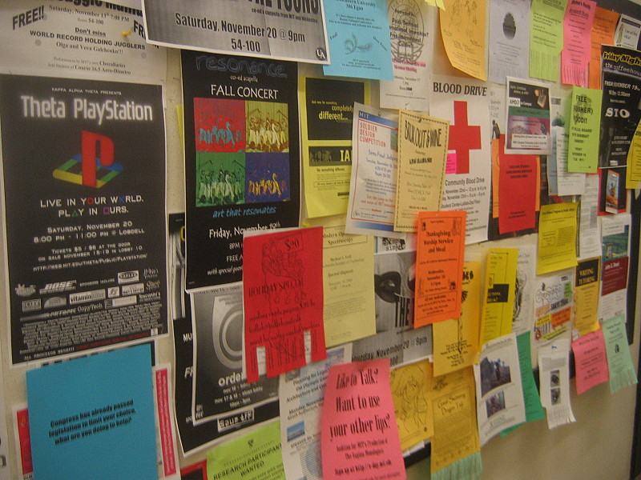
Motivation
Public displays' popularity has been increasing.
Most of the content is almost entirely non-interactive and consists of displaying announcements.
Bulletin boards are messy public spaces.
Notes:
Hard to find useful information
Hard to find changes
DIfficult to update changes

Slide 4
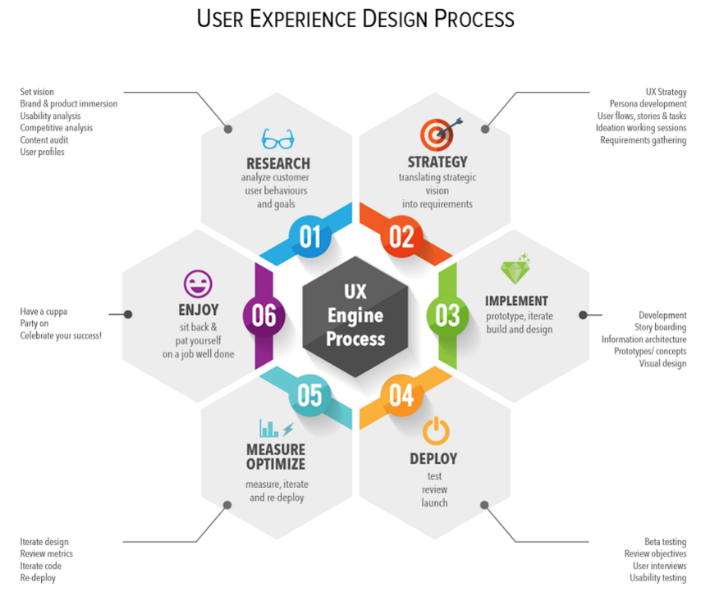
Design process
Research
Brainstorming ideas
identify capacity of the given devices
Idea decision
identify stakeholders
identify usability
identify viability
identify needs
Literature review
study similar systems
Specify goals and features
what are the requirements?

Slide 5
Design process
Strategy
Clarify requirements
categorize requirements
Identify possible issues
privacy issue
technical issue
reported issues from similar systems
Suggest solutions
solutions to proposed issues

Slide 6
Design process
Implement
Initial prototyping
hand-drawn wireframe for mobile system
hand-drawn wireframe for display system
Drawing system architecture
Create high-fidelity wireframe
using HTML/CSS, Powerpoint or other variety of tools

Slide 7
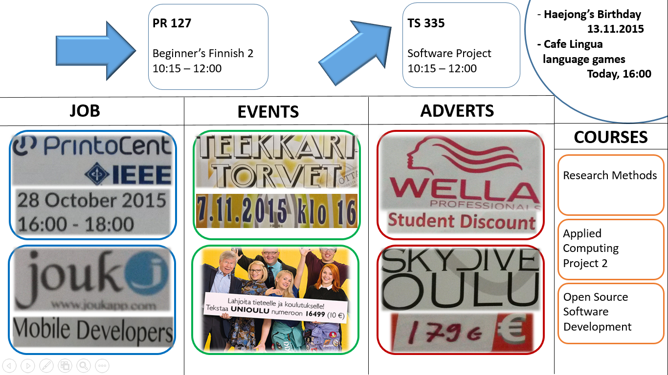
High fidelity prototype: Public display
Notes:
Content is color coded and has a specific title

Slide 8
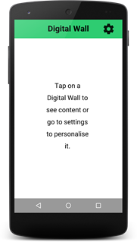
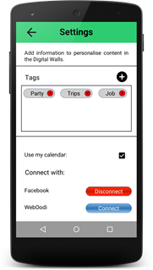
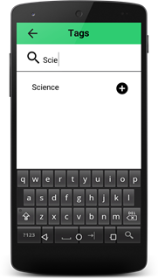
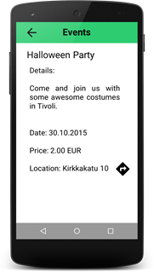
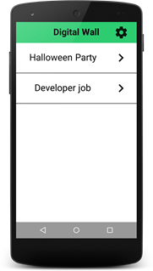
High fidelity prototype: Smartphone application
First Home Screen
Settings Screen
Add Tags Screen
Event from display
Home Screen
Notes:
Removed Menu
Added settings icon
Changed text of calendar

Slide 9
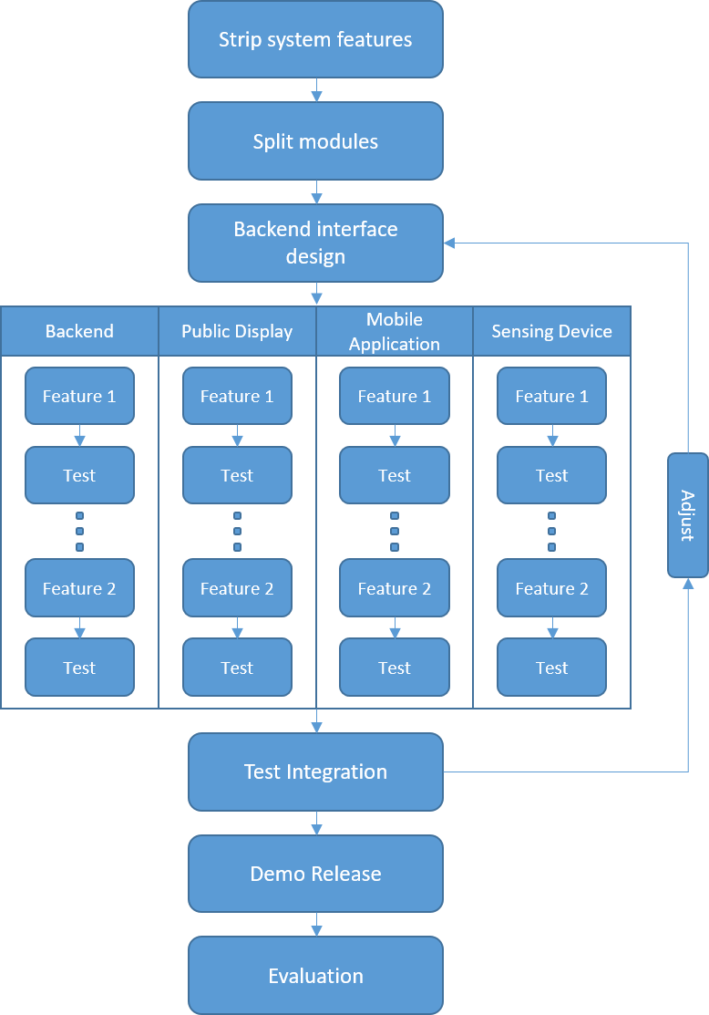
Implementation process
Features kept:
Device recognition through WiFi
Display personalisation
Dashboard to upload events
Support for several displays
Features dropped:
Custom map of the University
Special UI for each type of category on the phone
Navigation directions on the public display
Arrows on the public display showing the direction
Support for dynamic Mac Addresses
Notes:
Feedback to local government
Queue estimations
Micro tasks (as workstations)
More into our topic:
Personalise content: Google search, Youtube videos, songs, images, etc
Focused on security, how to communicate and find public displays

Slide 10
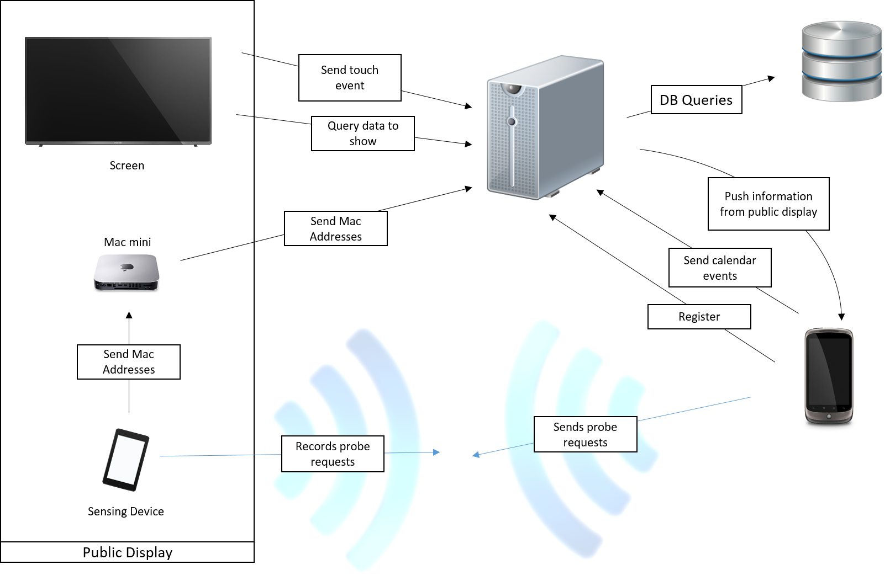
Software Architecture
Notes:
News non-actionable
Reminder actionable
Actionable has deadline and incites people to act
Discount, exam registration…
Non-actionable has no deadline and no action
Normal news or announcements

Slide 11
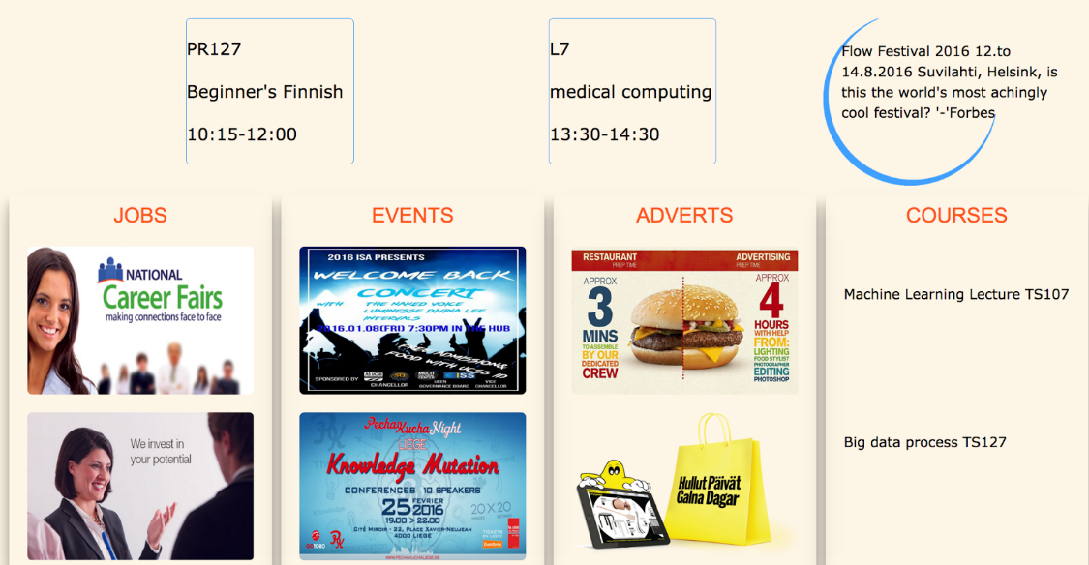
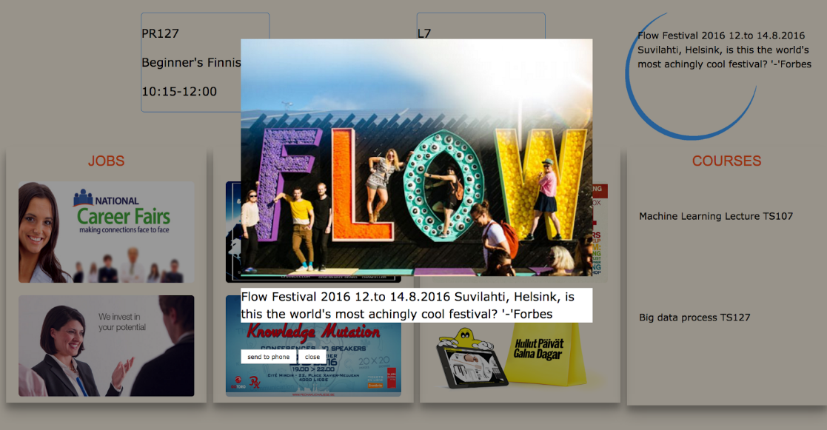
User Interface - Public Display
Public Display Homepage
Item Selected

Slide 12
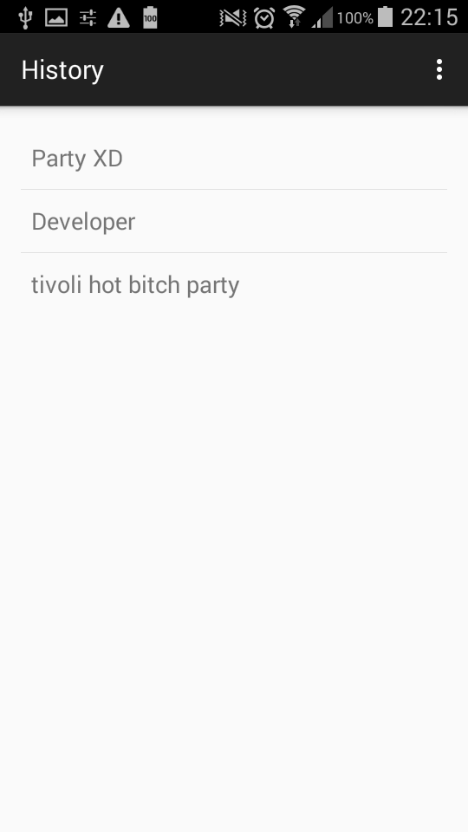
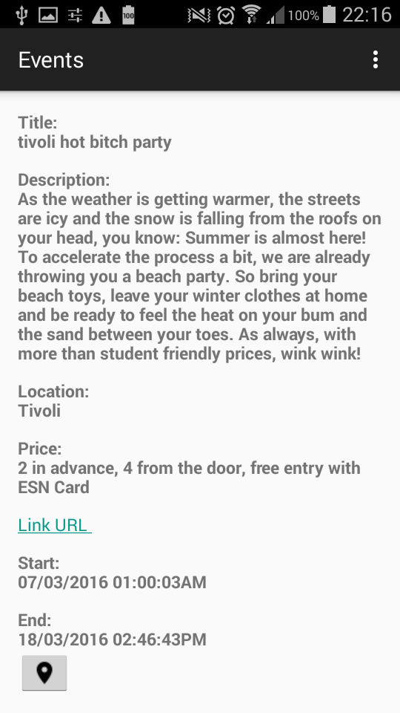
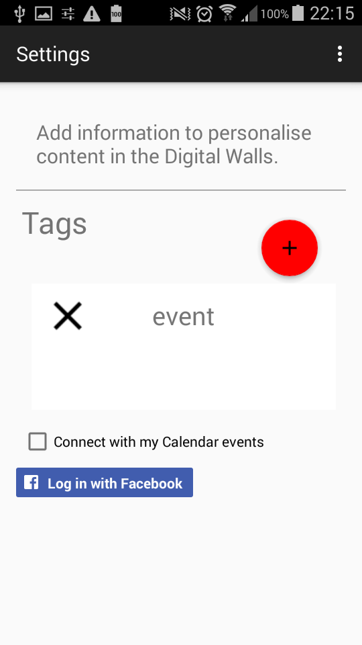
User Interface - Mobile Client
History
Event
Settings

Slide 13
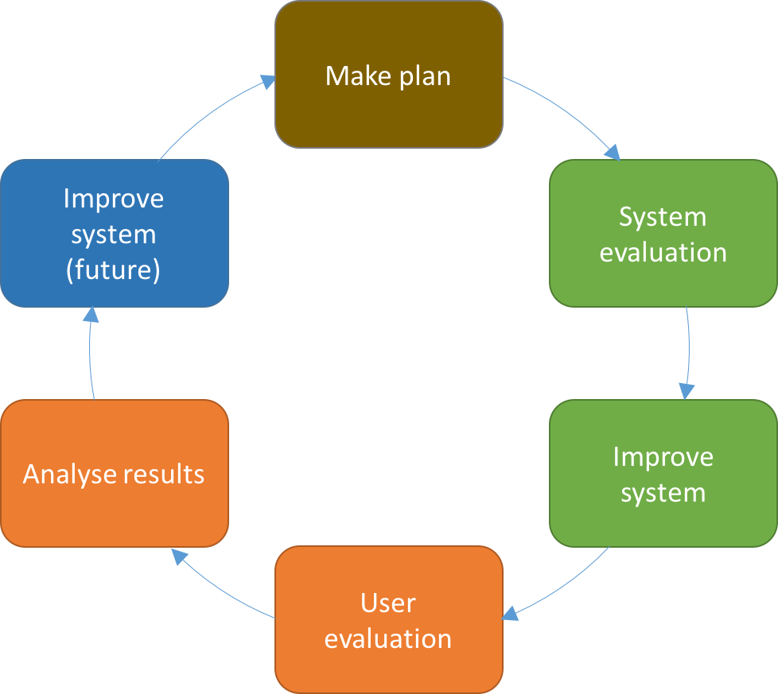
Evaluation process
Notes:
Feedback to local government
Queue estimations
Micro tasks (as workstations)
More into our topic:
Personalise content: Google search, Youtube videos, songs, images, etc
Focused on security, how to communicate and find public displays

Slide 14
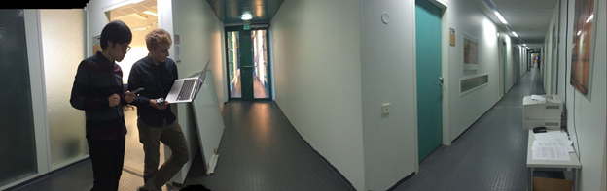
System Evaluation - User Detection
Speed of personalisation
Expected: 10-20 seconds
Measured: 28.6 seconds (25.6,31.3)
Maximum distance of recognition
Expected: < 46 meters
Measured: > 90 meters
Notes:
Speed: 20 samples
90 meters - 5 km/h - 2 minutes

Slide 15
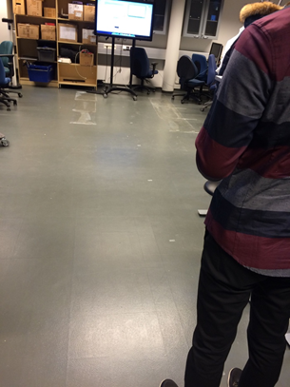
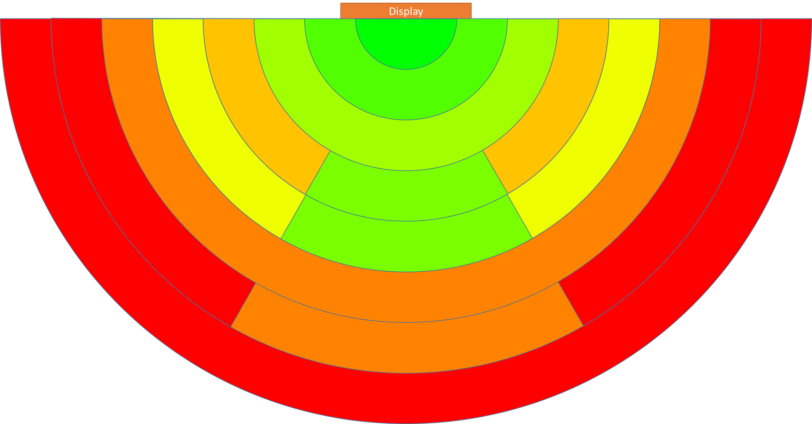
System Evaluation - User Proximity
Measured every meter (front and side)
Signal Strength heatmap
Expected: Many areas with false positives
Measured: Areas with false positives
Notes:
Speed: 20 samples
90 meters - 5 km/h - 2 minutes

Slide 16
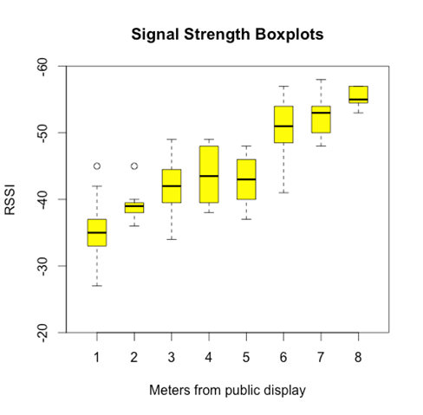
System Evaluation - User Proximity
Notes:
Speed: 20 samples
90 meters - 5 km/h - 2 minutes

Slide 17
User Evaluation
Process:
Public display
Few instructions, let them interact freely
Find information
Mobile application
Interact freely
Both
Gave some tasks
Q&A
One participant at a time
Few instructions
Notes:
Speed: 20 samples
90 meters - 5 km/h - 2 minutes

Slide 18
User Evaluation - Feedback
Too long to personalise.
System seemed like a search engine.
“I don’t know what information I may need, if I knew I would actively search for it”.
Automated personalization
Other results:
Hardware issue using touch system.
Sending content to the phone didn’t work properly because of the false positive areas.

Slide 19
Future Work
Discussion
Idea is viable.
UI tweaking necessary for users to understand the system.
Lack of experience with public displays makes it hard to understand.
Automated personalisation would be the final goal.
Passive system seen as an active system.
Improve dynamics of sending information to the phone.
Redesign the UI to communicate what the system does better.

Slide 20
Thank you for your time

